Slide 1
Vocabulary for WHAT

Slide 2
fork / fɔːk / noun a tool you use for picking up and eating food, with a handle and three or four points :
- Put the knives and forks on the table.

Slide 3
spoon / spuːn / noun an object that you use for eating, cooking, or serving food. It has a small bowl-shaped part and a long handle

Slide 4
plate / pleɪt / noun a flat and usually round dish that you eat from or serve food on :
- The plates were piled high with rice.
- a dinner plate

Slide 5
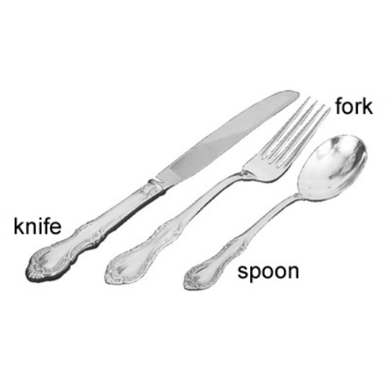

Slide 6
bowl / bəʊl / noun a wide round container that is open at the top, used to hold liquids, food, flowers etc
- Mix all the ingredients thoroughly in a large bowl.
- Fill the bowl with water.

Slide 7
fortune / ˈfɔːtʃən / noun a very large amount of money :
- He made a fortune selling property in Spain.
- My first painting sold for £25, a small fortune then for an art student.

Slide 8
synthetic / sɪnˈθetɪk / adjective produced by combining different artificial substances, rather than being naturally produced OPP natural :
- synthetic chemicals synthetic fibres/materials/fabrics

Slide 9
abreast / əˈbrest / adverb keep/stay abreast of something to make sure that you know all the most recent facts or information about a particular subject or situation :
- It’s important to keep abreast of the latest developments in computers.

Slide 10
polish / ˈpɒlɪʃ / noun a liquid, powder, or other substance that you rub into a surface to make it smooth and shiny furniture/shoe/floor etc polish

Slide 11
turn out phrasal verb to happen in a particular way, or to have a particular result, especially one that you did not expect turn out well/badly/fine etc
- It was a difficult time, but eventually things turned out all right.
- To my surprise, it turned out that I was wrong.

Slide 12
registered mail noun a method of sending a letter or package in which the person sending it can claim money if it arrives late or is lost or damaged

Slide 13
insure / ɪnˈʃʊə / verb to buy insurance so that you will receive money if something bad happens to you, your family, your possessions etc :
Have you insured the contents of your home? insure (something/somebody) against loss/damage/theft/sickness etc
It is wise to insure your property against storm damage. insure something for £1,000/$2,000 etc
You should insure the painting for at least £100,000.

Slide 14
disclose / dɪsˈkləʊz / verb formal to show something by removing the thing that covers it SYN reveal

Slide 15
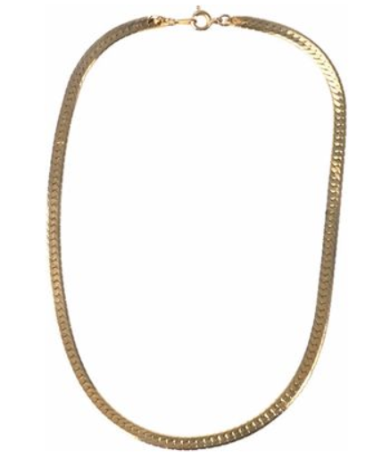
necklace / ˈnekləs, ˈneklɪs / noun a string of jewels, beads etc or a thin gold or silver chain to wear around the neck pearl/gold/diamond etc necklace
- She was wearing a coral necklace.

Slide 16
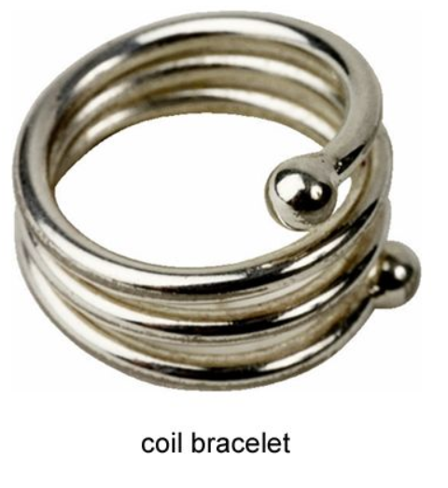
bracelet / ˈbreɪslət, ˈbreɪslɪt / noun a band or chain that you wear around your wrist or arm as a decoration
- a gold bracelet

Slide 17
clean up phrasal verb to make a place completely clean and tidy :
- We spent all Saturday morning cleaning up. clean something up
- plans to clean up the beaches

Slide 18
THANK YOU

